Slide 1

TIME SERIES FORECASTING
BY TANIA DAS

Slide 2
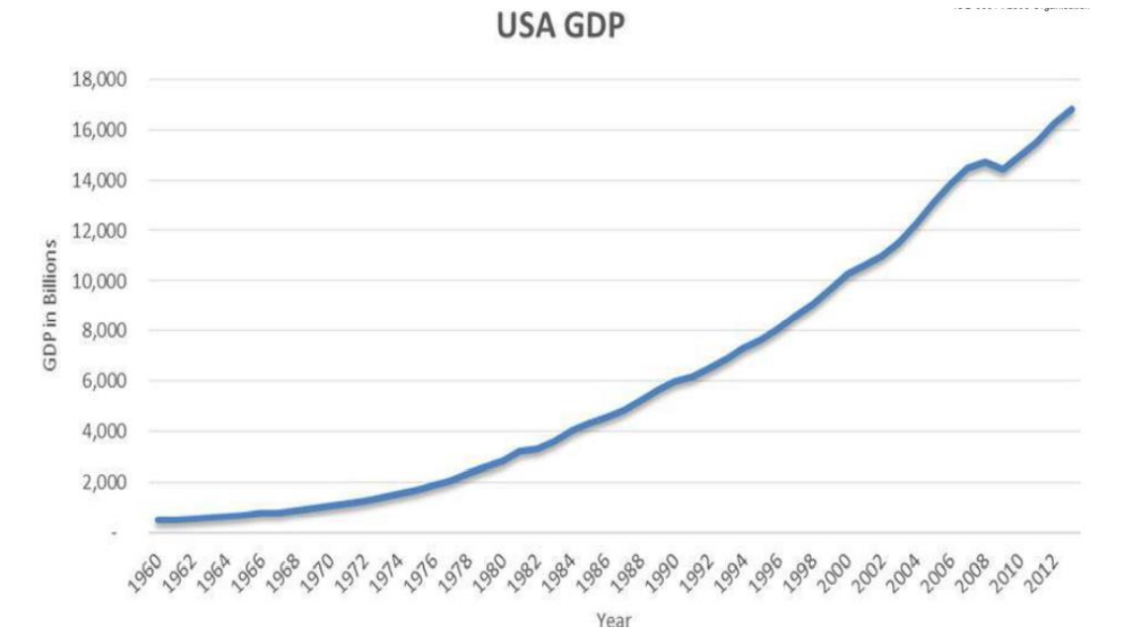
TIME SERIES:CONCEPT
What is Time Series data?
Time series data is a collection of observations (behavior) for a single subject (entity) at different time intervals (generally equally spaced as in the case of metrics, or unequally spaced as in the case of events).For example: the daily closing prices over one year for a single financial security, or a single patient’s heart rate measured every minute over a one-hour procedure.
Time Series Data: Examples (Yearly Data)
What is Time Series Analysis?
Time series analysis is a statistical technique that deals with time series data to extract patterns for predictions and other characteristics of the data. It uses a model for forecasting future values in a small time frame based on previous observations. It is widely used for non-stationary data , such as economic data , weather data, stock prices and retail sales forecasting.

Slide 3
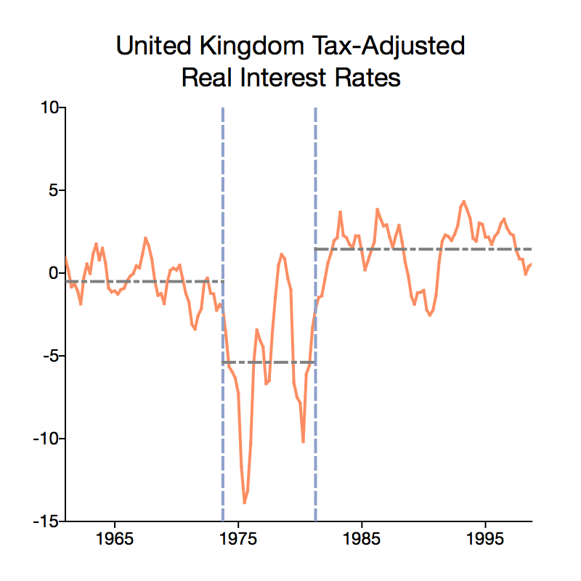
TIME SERIES-CONCEPTS
Time Series Components:
1)Structural breaks:
A component is called structural breaks when a time series abruptly changes at a point in time. This change could involve a change in mean or a change in the other parameters of the process that produce the series. This structural break affects the reliability of the results. Statistical methods should be used to identify the structural breaks.

Slide 4
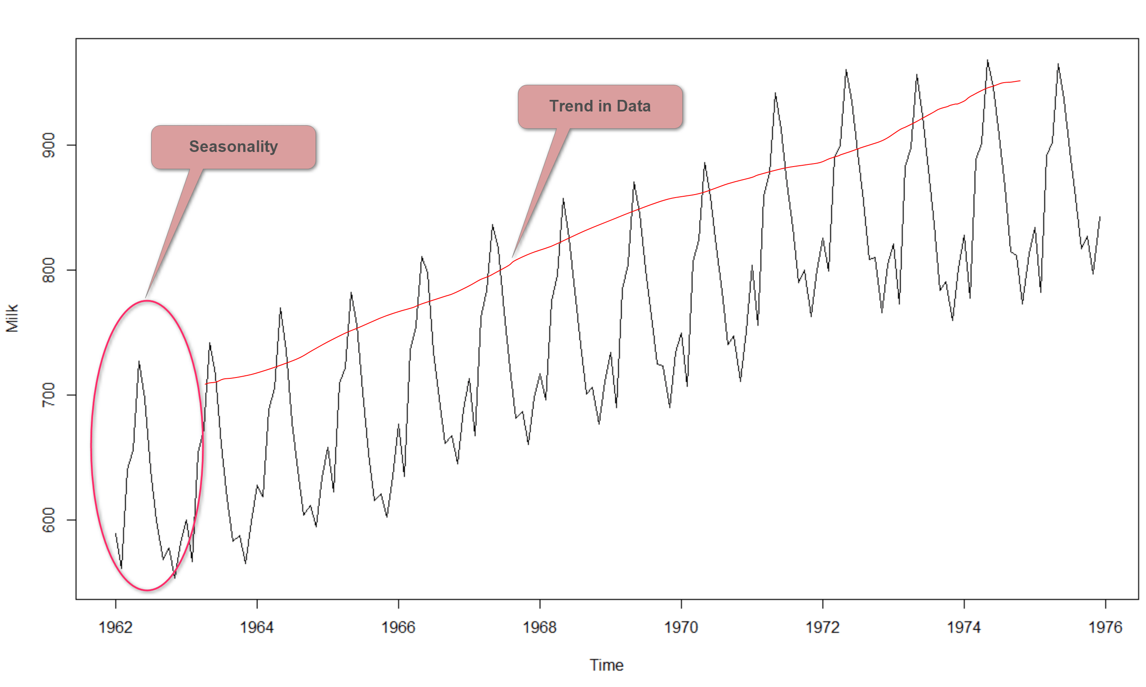
TIME SERIES-CONCEPT
2)Trend:
Trend is a pattern in data that shows the movement of a series to relatively higher or lower values over a long period of time. In other words, a trend is observed when there is an increasing or decreasing slope in the time series. Trend usually happens for some time and then disappears, it does not repeat. For example, some new song comes, it goes trending for a while, and then disappears. There is fairly any chance that it would be trending again.
3)Seasonality:
Seasonality is a component of a time series in which the data experiences regular and predictable changes that recur every calendar year. Any predictable fluctuation or pattern that recurs or repeats over a one-year period is said to be seasonal.

Slide 5
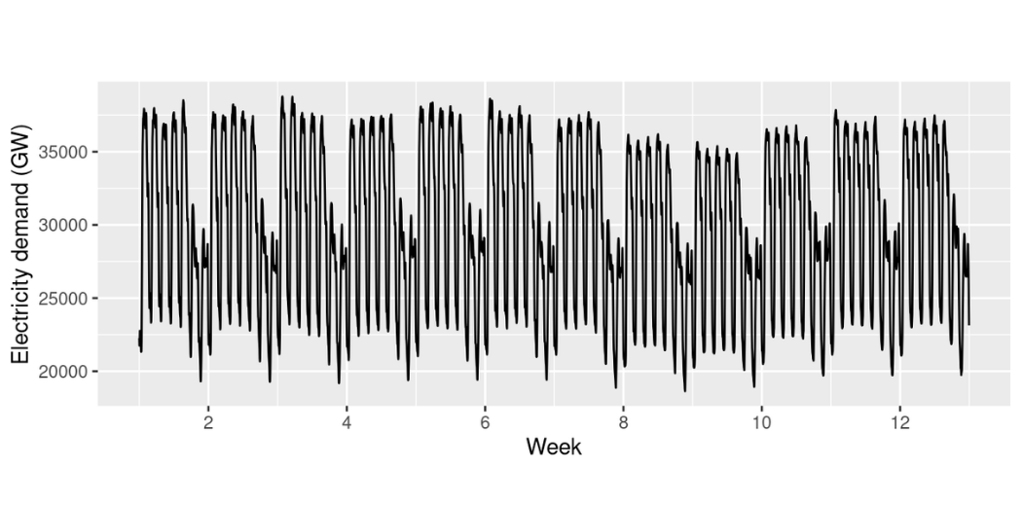
TIME SERIES-CONCEPT
4) Cyclicity:
Cyclicity is the component in which the time series data repeats after some interval of time. The interval is not fixed here.
Example:
Electricity demand per week is plotted in a time-series graph. The demand per 2 weeks repeats cyclically. This represents cyclicity.

Slide 6
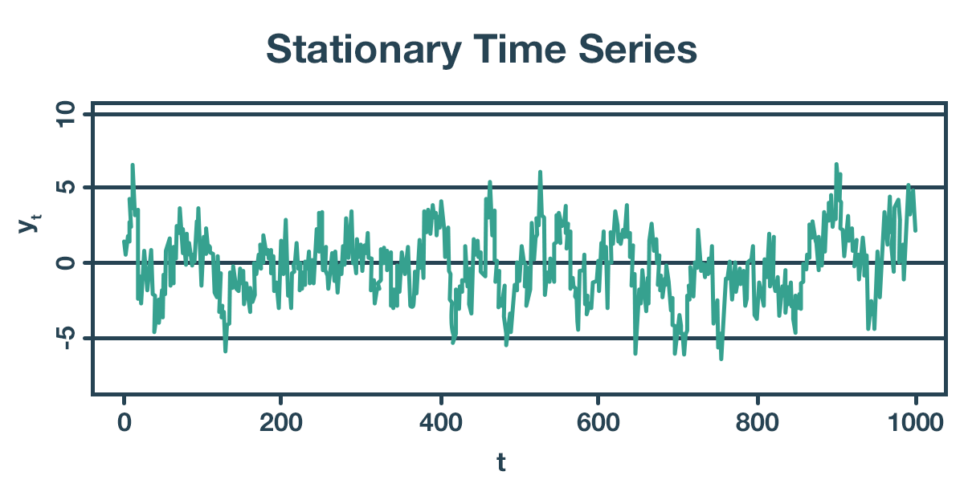
STATIONARITY:CONCEPT
What is stationarity?
A time series whose statistical properties, such as mean, variance, etc., remain constant over time, are called a stationary time series. In other words, a stationary time series is a series whose statistical properties are independent of the point in time at which they are observed. A stationary time series has a constant variance and it always returns to the long-run mean.
1. The mean of the series should not be a function of time rather should be a constant.
2. The variance of the series should not a be a function of time.
3. The covariance of the ith term and the (i + m)th term should not be a function of time.

Slide 7
STATIONARITY-CONCEPT
Types of Stationarity
Different types of stationarity are as follows.
Strict stationarity - This means that the unconditional joint distribution of any moments (e.g. expected values, variances, third-order and higher moments) remains constant over time. This type of series is rarely seen in real-life practice.
First-order stationarity - These series have a mean constant over time. Any other statistics (like variance) can change at the different points in time.
Second-order stationarity (also called weak stationarity) - These time series have a constant mean and variance over time. Other statistics in the system are free to change over time. This is one of the most commonly observed series in real-life practice.
Trend stationarity - These series are the series with a trend. This trend when removed from the series leaves a stationary series.
Difference stationarity - These series are the series that need one or more differencing to become stationary.

Slide 8
STATIONARITY-CONCEPT
Importance of Stationarity
The inferences drawn from a non-stationary process will not be reliable as its statistical properties will keep on changing with time. While performing analysis, you would typically be interested in the expected value of the mean, the variance, etc. But if these parameters are continuously changing, estimating them by averaging over time will not be accurate. Hence, stationary data are easier to analyze and any forecast made using a non-stationary data would be erroneous and misleading. Because of this, many statistical procedures applied in time series analysis makes an assumption that the underlying time series data is stationary. This assumption is necessary because most time series forecasting methods predict the statistical properties of the time series will remain the same in the future as they have been in the past.

Slide 9
DATASET
About The Data: It is a sales dataset. I have worked with two columns for the entire forecasting. The time series here is date and the dependent variable is sales.
Task: For the given data, build an Auto Regressive Moving Average (ARIMA) model which predicts 36 data
points ahead for the dependent variable: Sales

Slide 10
ARIMA-CONCEPT
The most popular approach towards econometric forecasting is Autoregressive Integrated
Moving Average (ARIMA) forecasting introduced by Box and Jenkins (1976)- also known as Box
Jenkins Methodology
The term ARIMA is derived from:
AR = Autoregressive
I=Integrated
MA=Moving Average
ARIMA assumes that the time series is stationary or can be made stationary by appropriate
further transformations

Slide 11
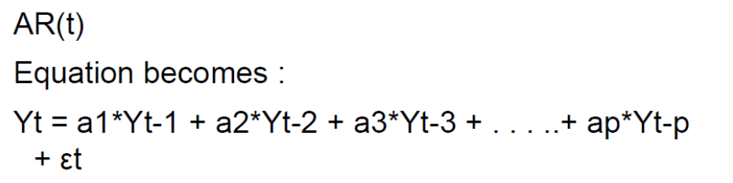
THE AR MODEL
An Autoregressive (AR) process is one where the current value of the model, Yt, depends upon
only the value the variable took in the previous period plus the error term.
AR(1) process:
Yt= aYt-1 + ut
Here, Yt is dependent of only the previous term and ut is the white noise error term
AR(p) process, here, p indicates the order of the AR model and hence the number of lagged
dependent variable

Slide 12
THE MA MODEL
A Moving Average (MA) process is one where the Yt is determined as a moving average of the
current and (intermediate) past values of the white noise error term.
MA(1) process:
Yt= ut + ut-1
Here, Yt is dependent of only the previous term and ut is the white noise error term
MA(q) process, here, q indicates the order of the MA model and hence the number of lagged
error term
For MA(q) the equation would look like:
Yt = A1et-1+A2et-2 + A3et-3+…+Aqet-q+u

Slide 13
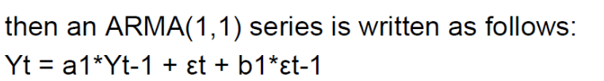
THE ARMA AND ARIMA MODEL
If we suppose that Yt has characteristics of both AR and MA, then it is called Autoregressive Moving Average (ARMA) process. An ARMA (1,1) represents and order of Auto-Regressive AR(1) and Moving Average MA (1)
If a time series is integrated of order d and we apply ARMA (p,q) to it, then we say that the
original time series is ARIMA (p,d,q) where d is no. of times the time series is differenced to
make it more stationary.
d~ represents the no. of time series needs to be differenced to make it stationary

Slide 14
STEPS OF ARIMA FORECASTING
TRANSFORMATION OF THE DATAINTO TIME SERIES DATA
PLOT THE DATA
MAKE DATA STATIONARY
DIFFERENCE THE SERIES
SATIONARY CHECK
PLOTTING THE DATA
AUGMENTED DICKY FULLER TEST
4. DETERMINE ORDER OF AR,MA AND I
5. APPLY ARIMA METHODOLOGY ON SATIONARY DATA
6. PREDICT FOR THE FUTURE
TRANSFORMATION OF THE DATA
First I have transformed the given data from a data frame to a time series data so that we can apply ARIMA on it . The starting date of the data is January 2003 and end date is January 2014 with a frequency of 12. It is a monthly time series data.

Slide 15
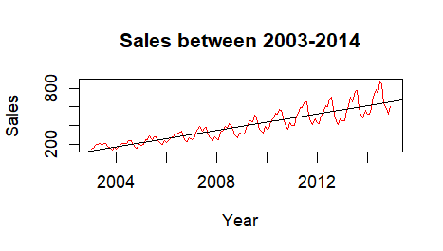
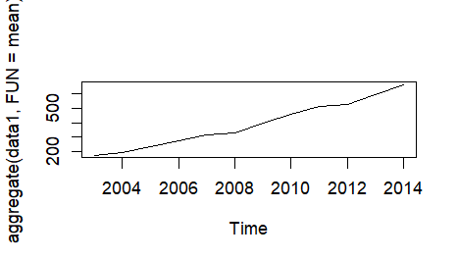
PLOT THE DATA
In the first figure I have plotted monthly sales on the Y-axis and date in the x-axis. We can see that the plot has seasonal fluctuations . With the help of the trend we can see that the data has an upward trend.
In the second figure I have plotted the mean of the sales over the given time frame.

Slide 16

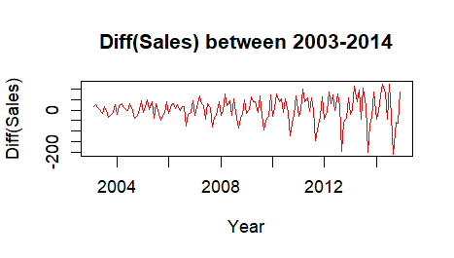
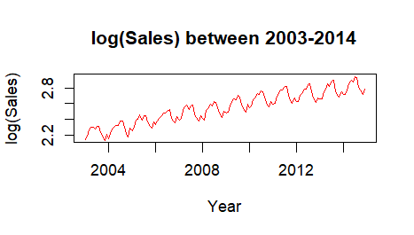
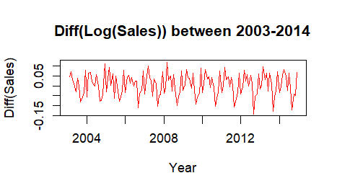
MAKING THE DATA STATIONARY
Since the data has trend and seasonal component, we can say that our data is not stationary and thereby it needs to be stationarized by the method of Differencing or by using log transformation. Differencing is a transform that helps stabilize the mean of the time series by removing changes in the level of a time series, which eliminates trend and seasonality. In this method, the difference of consecutive terms in the series is computed as below.
The step is done to decide how many times the series needs to be differenced to make it stationary. In the first diagram we have applied first order of differencing. The first-order difference transform consists of taking the data point at the current time and subtracting it with the point before. The result is a dataset of differences between points at time t. If the first-order difference is stationary and random, then it is called a “random walk” model. The differenced data continues to have unequal variance.
In the second diagram we have applied log of data in order to check whether the data is stationary or not. Over here also we saw that the data didn’t achieved stationarity.
So finally in the third diagram I have applied Differencing and Log transformation on the data to remove trend and unequal variance. We can see that Log10 and 1 order of differencing makes the series stationary.

Slide 17
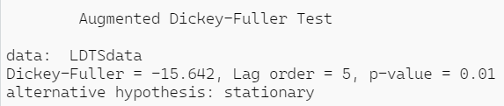
STATIONARY CHECK
Now we will take the first order difference and log10, then check for stationarity with the help of
Augmented Dickey-Fuller Test.
The Augmented Dickey-Fuller test is one of the most popular tests to check for stationarity. It tests the below hypothesis.
Null Hypothesis, H0: The time series is not stationary.
Alternative Hypothesis, H1: The time series is stationary.
If the p-value is less than or equal to 0.05 or the absolute value of the test statistics is greater than the critical value, you reject H0 and conclude that the time series is stationary.
If the p-value is greater than 0.05 or the absolute value of the test statistics is less than the critical value, you fail to reject H0 and conclude that the time series is not stationary.
The ADF statistic and the p-value of the first order differencing and the log10 of the data is as follows:
Since our data achieved p-value of 0.01 at first order differencing and log10 ,we will can reject H0 and accept H1,thus achieving stationarity at first order differencing and log10 and thereby fixing the value of d at 1.

Slide 18
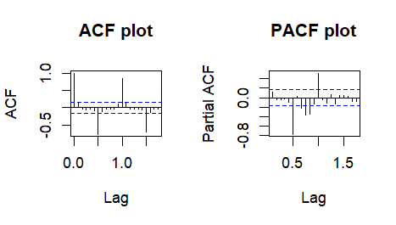
DETERMINE ORDER OF AR AND MA
Once a stationary series is obtained from differencing, we need to decide how many auto regressive (p) and moving average (q) terms are needed to build the forecasting model .The main tool used in the identification of the AR and MA order is Partial Auto Correlation Function (PACF) and Auto Correlation Function (ACF) respectively
Auto Correlation Function(ACF): measures the auto correlation between time period t and previous time periods
Partial Auto Correlation Function(PACF): measures the correlation between an observation s periods ago and the current observation, after the controlling the observations at the intermediate lag.
First plot depicts the ACF plot and second one shows the PACF plot.
From both the plots we can see that the first significant spike occurred at level 0,so we will take the value for p and q as 0 and we will check for the neighbouring value 1.

Slide 19
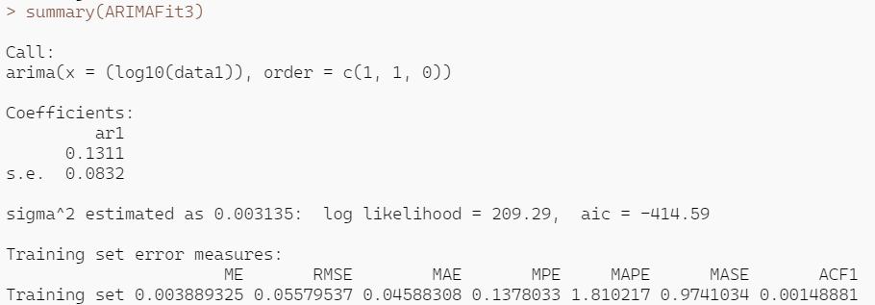
ARIMA MODEL
After determining the order of p and q and taking d =1 we have run the ARIMA model with different combination of p and q and derived the summary of each model having different combination of p and q. The model with the combination of p=1,d=1 and q=0 gave us the best fit model which we measured on the basis of the model having the lowest mape. The summary of the model is given below
Though we have got the best fit model through ARIMA ,still we need to run auto-arima as our data has seasonal component in it and ARIMA is not designed to handle seasonality.

Slide 20
TIME SERIES FORECASTING WITH AUTO-ARIMA
Auto ARIMA is an extension of ARIMA that supports univariate time series data with a seasonal component. Auto ARIMA requires selecting hyperparameters for both the trend and seasonal elements of the series.
Trend Elements
There are three trend elements that require configuration:
p: Trend autoregression order. d: Trend difference order. q: Trend moving average order.
Seasonal Elements
There are four seasonal elements:
P: Seasonal autoregressive order. D: Seasonal difference order. Q: Seasonal moving average order. m: The number of time steps for a single seasonal period.
The notation for a Auto ARIMA model is specified as: ARIMA(p,d,q)(P,D,Q)m
I have fixed the value for m as 12,since our data shows seasonal fluctuations after every 12 months.
The combination of Auto ARIMA(0,1,1)x(2,1,1,12) yields the lowest mean absolute percentage error (i.e. the sum of the individual absolute errors divided by each period separately) of 0.4468499 .Therefore we should consider this to be the optimal option.

Slide 21
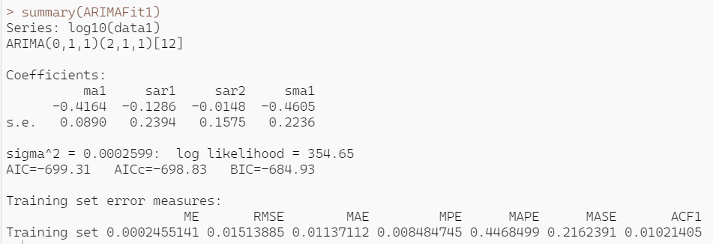
SUMMARY OF THE AUTO-ARIMA MODEL
The next step is to derive the summary of the Auto ARIMA model with the combination of p=0,q=1,d=1,P=2,Q=1,D=1,m=12

Slide 22
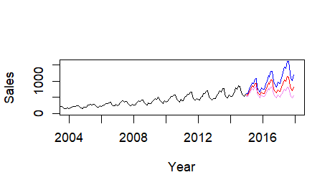
VISUALIZING THE FORECAST
We have done the exponential of the data since we have log earlier in order to predict sales for next 36 months. The black line give us the actual values, red line give us the predicted values and the blue and pink lines give us the +-2 standard error to range of expected error.

Slide 23
THANK YOU

